Slide 1
Unit -6 Multithreading in Java
Presented by
Manish Kumar Kakhani

Slide 2
Outline
Program , Process and Thread
Process V/S Thread
Multitasking and Multithreading
Life Cycle of Thread and Thread State Diagram
How to create a thread
Thread class and its method
Runnable interface
Thread Priorities
Main thread
Creating mutliple threads

Slide 3
What is program, process and thread ?
Program : Set of statements to perform specific task
Process : Program in execution
Thread : flow of execution within process

Slide 4
Difference between process and thread
Process | Thread
Each process have its own address in memory i.e. each process allocates separate memory area | Threads share the same address space
Process is heavyweight | Thread is lightweight
Cost of communication between the process is high | Cost of communication between the thread is low
Switching from one process to another require some time for saving and loading registers, memory maps, updating lists etc | Switching between threads is fast

Slide 5
Multitasking
Multitasking is a process of executing multiple tasks simultaneously.
We use multitasking to utilize the CPU.
Multitasking can be achieved by two ways:
-Process-based Multitasking(Multiprocessing)
-Thread-based Multitasking(Multithreading)

Slide 6
Multithreading
Multithreading in java is a process of executing multiple threads simultaneously.
In multithreading , threads share a common memory area. They don't allocate separate memory area so saves memory, and context-switching between the threads takes less time than process.
Java Multithreading is mostly used in games, animation etc.

Slide 7
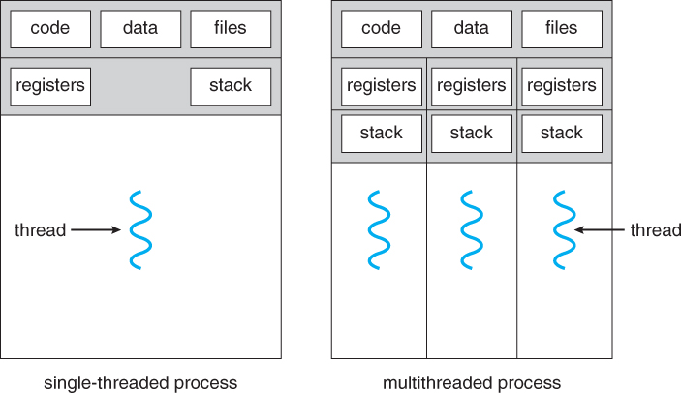

Slide 8
Advantages of multithreading
Complete use of CPU ( Improves CPU utilization)
Better system performance

Slide 9
Life Cycle of a thread ( Thread states)
New
Ready ( Runnable )
Running
Waiting ( Blocked/Non-Runnable )
Terminated

Slide 10
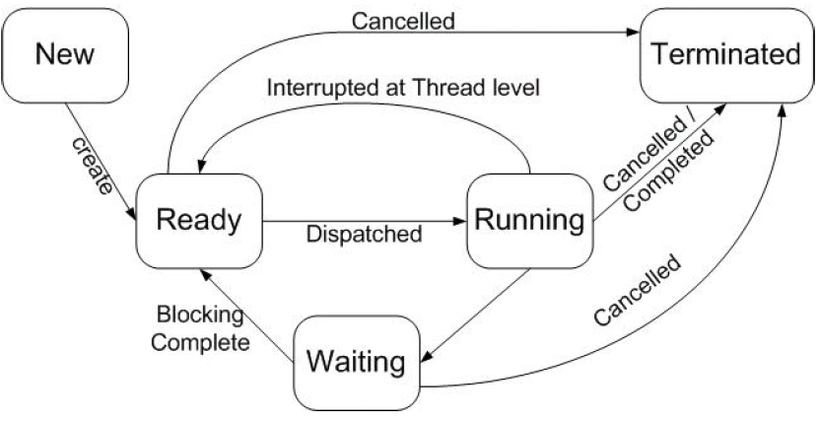
Thread state diagram

Slide 11
New: The thread is in new state if you create an instance of Thread class but before the invocation of start() method.
Runnable : The thread is in runnable state after invocation of start() method, but the thread scheduler has not selected it to be the running thread.
Running: The thread is in running state if the thread scheduler has selected it.
Non-Runnable (Blocked): This is the state when the thread is still alive, but is currently not eligible to run.
Terminated: A thread is in terminated or dead state when its run() method exits.

Slide 12
How to create thread?
There are two ways to create a thread:
( i ) By extending Thread class
( ii ) By implementing Runnable interface.

Slide 13
Thread class
Thread is in-built class in Java
Thread class provide constructors and methods to create and perform operations on a thread.
Thread class extends Object class and implements Runnable interface.
Commonly used Constructors of Thread class
- Thread()
- Thread(String name)
- Thread(Runnable r)
- Thread(Runnable r, String name)

Slide 14
Built-in Methods of Thread Class
getName(): It is used for Obtaining a thread’s name
setName()-Changes the name of the Thread object
getPriority(): Obtain a thread’s priority
setPriority()-Sets the priority of this Thread object. The possible values are between 1 and 10.
start(): start a thread by calling its run() method
run(): Entry point for the thread
isAlive(): Determine if a thread is still running
join(): Wait for a thread to terminate
sleep(): suspend a thread for a period of time ( Specified in milliseconds)

Slide 15
Runnable interface
The Runnable interface should be implemented by any class whose instances are intended to be executed by a thread.
Runnable interface have only one method named run()
public void run(): is used to perform action for a thread.

Slide 16
Example : By extending Thread class
class Multi extends Thread{
public void run(){
System.out.println("thread is running...");
}
public static void main(String args[]){
Multi t1=new Multi();
t1.start();
}}
Output :thread is running

Slide 17
Example-By implementing the Runnable interface:
class Multi implements Runnable{
public void run(){
System.out.println("thread is running..."); }
public static void main(String args[]){
Multi m1=new Multi();
Thread t1 =new Thread(m1);
t1.start(); } }
Output: thread is running...

Slide 18
If you are not extending the Thread class, your class object would not be treated as a thread object. So you need to explicitly create Thread class object.
We are passing the object of your class that implements Runnable so that your class run() method may execute.

Slide 19
Thread Priorities
Every Java thread has a priority that helps the operating system determine the order in which threads are scheduled.
Java thread priorities are in the range between MIN_PRIORITY (a constant of 1) and MAX_PRIORITY (a constant of 10).
By default, every thread is given priority NORM_PRIORITY (a constant of 5).
Threads with higher priority are more important to a program and should be allocated processor time before lower-priority threads.
However, thread priorities cannot guarantee the order in which threads execute and very much platform dependent.

Slide 20
Main Thread
When a Java program starts up, one thread begins running immediately. This is usually called the main thread of your program, because it is the one that is executed when your program begins. The main thread is important for two reasons:
(i)It is the thread from which other "child" threads will be spawned.
(ii)It must be the last thread to finish execution. When the main thread stops, your program terminates
Although the main thread is created automatically when your program is started, it can be controlled through a Thread object. To do so, you must obtain a reference to it by calling the method currentThread( ), which is a public static member of Thread.
Its general form is shown here: public static Thread currentThread( )
This method returns a reference to the thread in which it is called. Once you have a reference to the main thread, you can control it just like any other thread.

Slide 21
Example- Controlling the Main Thread
class CurrentThreadDemo { public static void main(String args[]) { Thread t = Thread.currentThread(); System.out.println("Current thread: " + t); // change the name of the thread t.setName("My Thread"); System.out.println("After name change: " + t); try { for(int n = 5; n > 0; n—) { System.out.println(n); Thread.sleep(1000); } } catch (InterruptedException e) { System.out.println("Main thread interrupted"); } }}

Slide 22
Output :
Current thread: Thread[main,5,main] After name change: Thread[My Thread,5,main] 5 4 3 2 1
By default, the name of the main thread is main.
Its priority is 5, which is the default value
main is also the name of the group of threads to which this thread belongs. A thread group is a data structure that controls the state of a collection of threads as a whole

Slide 23
Class InterruptedException
Thrown when a thread is sleeping for a long time and another thread interrupts it using the interrupt method in class Thread.

Slide 24
Example -Creating multiple thread in java
class NewThread implements Runnable
{ String name; // name of thread
Thread t;
NewThread(String threadname)
{ name = threadname;
t = new Thread(this, name);
System.out.println("New thread: " + t);
t.start(); // Start the thread }

Slide 25
public void run() {
try {
for (int i = 5; i > 0; i--)
{ System.out.println(name + ": " + i);
Thread.sleep(1000); } }
catch (InterruptedException e)
{ System.out.println(name + "Interrupted"); }
System.out.println(name + " exiting."); } }

Slide 26
class MultiThreadDemo {
public static void main(String args[]) {
new NewThread("One"); // start threads
new NewThread("Two");
new NewThread("Three");
try { Thread.sleep(10000); }
catch (InterruptedException e)
{ System.out.println("Main thread Interrupted"); }
System.out.println("Main thread exiting."); } }

Slide 27
Output
New Thread :Thread[One,5,main] New Thread : Thread[Two,5,main] One:5 Two:5 New Thread : Thread[Three,5,main] Three:5 One:4 Three:4 Two:4 One:3 Three:3 Two:3 One:2 Three:2 Two:2 One:1 Three:1 Two:1 One exiting Three exiting Two exiting Main Thread Exiting

